Slide 1

Optimizing Cosmetic Formulations Using Product Reformulation Trends
Olivia Folly-Gah

Slide 2
Objective
Identify trends in cosmetic product reformulations due to hazardous ingredients.
Sub-Objectives:
Finalized Baseline: Balance dataset via undersampling to reduce class imbalance.
Model Development: Compared machine learning models (Logistic Regression, Random Forest, Gradient Boosting, XGBoost).
Model Evaluation: Assess models using ROC-AUC, Precision, Recall, and F1-score.
Notes:
focusing on overcoming challenges related to class imbalance, model evaluation, and fine-tuning.

Slide 3
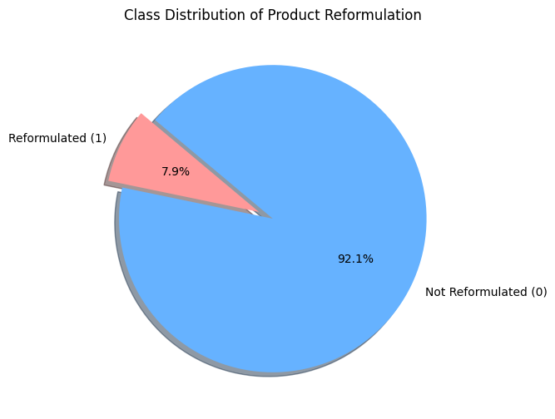
Understanding
Overview of the Dataset: The Target column is whether a product has been reformulated.
Undersampling: Kept all 597 reformulated cases and sampled 1,000-10,000 non-reformulated cases ton balance training data.
Machine Learning Models: Logistic Regression (Baseline) and using ROC- AUC as a primary metric
Notes:
The features were 15 numerical variables representing product and ingredient characteristics.
Issue: Severe class imbalance (very few reformulated cases

Slide 4
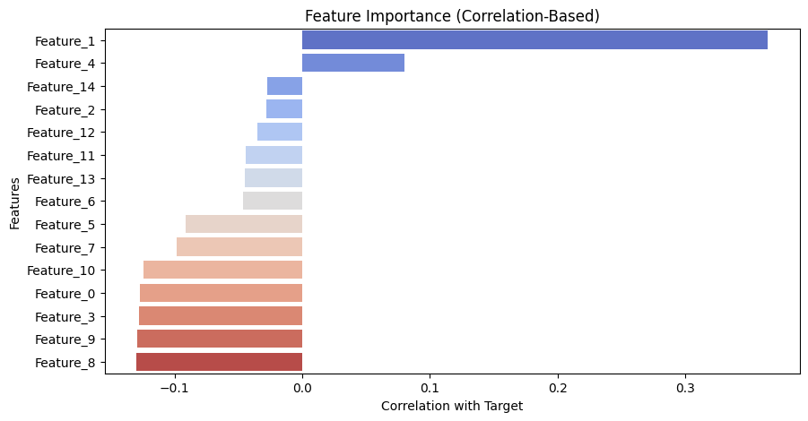
Feature Correlation Analysis
Notes:
✅ Feature_1 is the most influential feature – It has the highest correlation with the target (0.365), making it a strong predictor of reformulation. ✅ Risk of Overfitting – Since Feature_1 is much more correlated than other features, the model might overly rely on it, leading to poor generalization. ✅ Potential Data Leakage Concern? – While not extreme (correlation < 0.9), Feature_1's influence suggests it could be capturing information too closely tied to the target. ✅ Next Steps –
Test models with and without Feature_1 to evaluate its true impact.
Check feature importance in tree models to confirm reliance.
Apply regularization or feature selection if overfitting persists.

Slide 5
Key Results - Model Performance
Model | ROC-AUC (5,000 non-reformulated) | ROC-AUC (7,000 non-reformulated) | ROC-AUC (10,000 non-reformulated)
Logistic Regression | 0.840 | 0.850 | 0.9082
Random Forest | 1.000 | 1.000 | 1.000
Gradient Boosting | 1.000 | 1.000 | 1.000
XGBoost | 1.000 | 1.000 | 1.000
Notes:
Findings & Interpretations
Logistic Regression gave more reasonable scores (0.84-0.85 ROC-AUC).
Random Forest, Gradient Boosting, and XGBoost had perfect scores, indicating potential overfitting or data leakage.
Feature Correlation Analysis showed Feature_1 had the highest correlation with the target (0.365), possibly affecting model generalizability.

Slide 6
Solutions to Model Challenges
Challenges
Solutions
⚖️ Severe class imbalance → Risk of biased models
🌲 Tree models overfitting → Perfect 1.0 scores
🔍 Finding the right balance → How much undersampling is too much?
🔄 Undersampling – Tested 1,000-10,000 samples to find an optimal balance.
📊 Feature Analysis – Identified Feature_1 (0.365 correlation) as a potential overfitting source.
🛠️ Model Complexity – Limited tree depth & estimators to reduce overfitting.
Notes:
Test removing Feature_1 & monitor impact.
Explore alternative resampling methods (SMOTE).

Slide 7
Future Plans
🎯 Feature Selection:
Remove Feature_1 and re-run models.
Compare model performance with & without Feature_1.
🛠️ Hyperparameter Tuning:
Reduce complexity in Random Forest, Gradient Boosting, XGBoost by:
Limiting tree depth
Adjusting the number of estimators
Setting min_samples_split & min_samples_leaf
🔄 Alternative Sampling Methods:
Test SMOTE (synthetic data generation) instead of undersampling.
Compare performance & generalization across different resampling techniques.
📊 Model Generalization:
Evaluate models on an unseen validation set to verify reliability.
Check if overfitting is reduced after adjustments.
Notes:
To reduce overfitting, we’ll explore regularization methods.
Improving precision for Class 1 is key, so we’ll fine-tune resampling and decision thresholds.
Feature engineering could further boost performance, so we’ll experiment with additional features.
1. Time-Based Features
Time Since Initial Report – Number of days since the product was first reported with the hazardous ingredient.
Year of Reformulation – Some years may have higher reformulation rates due to regulatory changes.
Time Between Reports – Measure how frequently reformulation happens after initial reporting.
2. Product-Specific Features
Product Category – Certain categories (e.g., cosmetics vs. cleaning products) may have different reformulation trends.
Brand Reputation – Some brands might reformulate faster due to consumer pressure or regulations.
Product Lifecycle Stage – Older products may be less likely to be reformulated.
3. Hazard-Related Features
Number of Hazardous Chemicals – Products with more hazardous chemicals may be more likely to be reformulated.
Hazard Severity Score – Convert categorical hazard levels into a numerical risk score.
Regulatory Flag – Identify whether the chemical is flagged by specific regulatory agencies (e.g., FDA, EPA).
4. Market & External Factors
Consumer Awareness Trends – Use external data like search trends for hazardous ingredients.
Regulatory Policy Changes – Flag if the product’s reformulation aligns with major regulatory updates.
Competitor Actions – If competitors reformulate similar products, it may influence other brands.
5. Chemical-Specific Features
Chemical Type – Categorize chemicals (e.g., heavy metals, endocrine disruptors, carcinogens).
Toxicity Score – Use publicly available databases to assign toxicity scores.
Persistence in Products – Some chemicals may have longer lifespans in formulations before removal.

Slide 8
Conclusion
Key Issue | Findings | Next Steps
Tree-Based Models Overfitting | Perfect Scores (1.0) → Indicates overfitting | Feature selection & tuning
Logistic Regression Performance | More reasonable (ROC-AUC: 0.84-0.85) | Use as baseline model
Model Generalization | Need better balance & feature selection | Test on unseen validation data
Notes:
Left Column – Key Issues
"First, we faced a few major challenges throughout this project."
Severe Class Imbalance: "The dataset was highly imbalanced, with very few reformulated products compared to non-reformulated ones. This made model training difficult, as models tended to favor the majority class."
Tree-Based Model Overfitting: "Random Forest, Gradient Boosting, and XGBoost all achieved near-perfect scores, which is unrealistic and suggests overfitting—likely due to class imbalance and the influence of certain features."
Feature Correlation & Influence: "We found that Feature_1 had the highest correlation (0.365) with the target, making it a key factor in predictions. However, this strong correlation may also lead to over-reliance on one feature, reducing generalizability."
Middle Column – Key Findings
"Despite these challenges, we gained several important insights."
Logistic Regression Performed More Realistically: "Unlike tree-based models, Logistic Regression produced more reasonable ROC-AUC scores (0.84 - 0.85), meaning it might generalize better."
Feature_1’s Strong Influence on Model Predictions: "Feature_1 had a significant correlation with the target, making it a possible source of overfitting. This suggests that reducing its impact or removing it could improve model generalization."
Sampling Strategy Matters: "Different levels of undersampling produced different results. We tested datasets with 1,000 to 10,000 majority class samples to find a balance between model stability and performance."
Right Column – Next Steps
"So what are our next steps?"
Feature Selection: "We'll test the model with and without Feature_1 to determine its true impact and see if removing it improves generalization."
Hyperparameter Tuning: "We need to adjust tree model parameters, such as reducing tree depth and the number of estimators, to prevent overfitting."
Alternative Sampling Methods: "Instead of just undersampling, we will test SMOTE, which generates synthetic minority class samples to improve balance without losing data."
Generalization Testing: "Finally, we’ll validate our models on an unseen test set to ensure they perform well on new data and aren't just memorizing patterns from training."
Closing Statement: "Overall, we’ve identified key areas where our models can be improved. By refining feature selection, adjusting complexity, and exploring different sampling techniques, we can move toward a more balanced and reliable model for predicting cosmetic product reformulation."

